Slide 1
Control Flow and Looping
By: Engr. Asif Ali

Slide 2
Contents
Conditional statements
Conditional statement(if satement)
Conditional statement(if-else statement)
Conditional execution(if-elif-else)
Iterations
While loop
Tasks

Slide 3
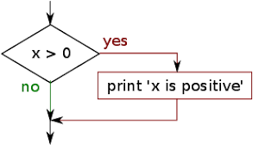
Conditional Statement if statement

Slide 4
Conditional Statement
Conditon will be checked if the condition is true then body of the if statement will be executed otherwise it will not be executed.

Slide 5
Activity-01
x = 5
if x>5:
print(“It is positive number”)

Slide 6
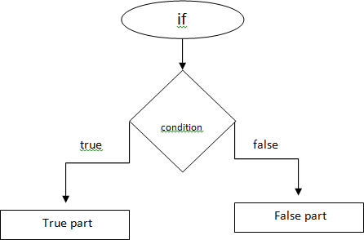
if-else statement
else

Slide 7
Activity-02
x = 5 if x>0:
print("Number is positive")
else:
print("Number is negative")

Slide 8
Activity-03
Write a python code which check you’r department.If your department is CSE
then It’s OK otherwise It’s not OK.
Output:
Enter your Department: CSE
It’s OK Otherwise It’s not OK

Slide 9
if-elif-else
if condition:
Body of if elif: condition:
Body of elif
elif: condition:
Body of elif
else:
Body of else

Slide 10
Activity-04 Week days choice
number = int(input("Enter any number:"))
if number==1:
print("Monday")
elif number==2:
print("Tuesday")
elif number==3:
print("Wednesday")
elif number==4:
print("Thursday")
elif number==5:
print("Friday")
elif number==6:
print("Saturday")
elif number==7:
print("Sunday")
else:
print("Invalid choice")

Slide 11
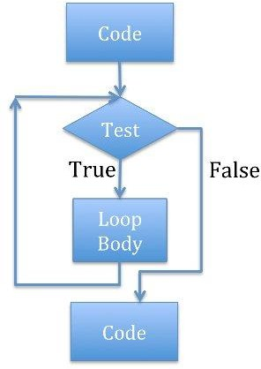
Iterations

Slide 12
Iterations
Control statement: In this,code is first tested.If the conditon is true then code will be executed again and again untill and unless condition becomes false.

Slide 13
while loop
a = 1
while a<=5: print(a) a=a+1

Slide 14
Activity-04
Write a python program which print number of Pakistan by taking user’s choice.
Enter any number:2 Pakistan
Pakistan

Slide 15
Activity-05
Write a python program which display numbers from 10 to 1
Sample Output:
10
9
8
7
6
5
4
3
2
1

Slide 16
Activity-06
Write a python program which display numbers from 10 to 1 but it should skip 5
Sample Output:
10
9
8
7
6
4
3
2
1

Slide 17
Nested While Loop
a = 1
b = 1
while a<=5:
b = 1
while b<=5:
print(f'a : {a} b : {b}')
b +=1
a += 1

Slide 18
Random Number
Random number is used to generate random numbers
Example:
import random
n = random.random()
print(n)

Slide 19
Activity-07
Create random from 1 to 10
Sample Output:
Random number: 5

Slide 20
Activity-08
Write a python program which takes even number until user does not enter odd number and finaly display total sum.If the user enter odd then program should be terminated.
Output:
Enter any number:2 Enter any number:6 Enter any number:4 Enter any number:1 Total Sum is: 12

